Slide 1

Reducing LLM hallucination with Retrieval Augmented Generation
Notes:
Good evening, everyone, hope you guys are enjoying the time at the event. Today I would like to share a bit of my experience in building an LLM application, specifically using a recently popular technique called Retrieval Augmented Generation or RAG. Just maybe a quick show of hands, how many of you have built RAG LLM application?

Slide 2
Outline
1. What is RAG ?
2. How to evaluate RAG ?
3. How to improve RAG pipeline ?
4. Develop and optimize RAG pipeline (Code)

Slide 3
Recap: LLM limitations in medicine
Knowledge Cutoff
Lack of medical domain knowledge
Hallucination
Solution: RAG vs Fine-Tuning
Notes:
So what is RAG and why do we want to use RAG together with LLM? First let’s look back at some of the limitations of pretrained Large Language Models.
We know that pretrained LLMs are limited by whatever knowledge inside the training dataset. This means the models won’t have access to updated knowledge beyond the cutoff date of training dataset. For example, if you ask ChatGPT about say Covid Omicron variant, GPT simply is unable to answer because Omicron starts around November 2021 but knowledge cutoff date of GPT is September 2021.
Another problem, also with training dataset is that while the training corpus is huge, it is still a very small portion of the overall mankind knowledge, which means that there can be many areas which the training data does not cover and therefore the models don’t have the domain-specific knowledge.
The last problem probably the most common one, is hallucination, where the models giving very confident but then factually wrong answers.
To address these problems, there are two main families of solution, RAG or Fine-Tuning each address very different aspects of LLM’s capabilities.

Slide 4

What is Retrieval Augmented Generation (RAG)?

Slide 5
RAG
Vector Database
KG Database
Knowledge Base
Retriever
Extract Relevant Docs
Context
Question
Prompt
LLM
Answer
Retrieval Augmented
Generation
Notes:
First, generation in RAG is the typical way we interact with LLM, whereby we have questions or tasks, then we create the prompt and finally run the GPT model to generate the answers.
The first step of implementing RAG, in addition the normal prompts, is to provide additional information inside the prompt as the form of contexts and then also instruct in the prompt asking the LLM to explicitly execute the task while only using the given information.
The concept of providing contexts information and grounding the model on the contexts help LLM to overcome many problems which we just mention. We have a cheap way to provide updated information, domain-specific information without the need to retrain the entire model. Secondly, grounding the LLMs to work on small, targeted information helps to add control and reduce the stochasticity of generation process, thus help to reduce hallucination.
But now since we have an additional step of feeding grounded information, what should we give the model. Obviously we want the model to have access to all the information, but at the same time we don’t want to dump everything inside the prompt for 2 reasons. First, there is a token limitation which limit how long a prompt can be, and secondly it turns out when we feed a lot of information, LLMs can struggle to find the exact part of the contexts that is needed to answer the question.
To address this, a second component, a retrieval system is implemented to handle what should be provided to the LLMs. Usually we will have a knowledge base which contain all the relevant domain-specific knowledge, can be a vector database, graph database and a retriever engine which will help decide what should be extracted from the database to answer a certain question.

Slide 6



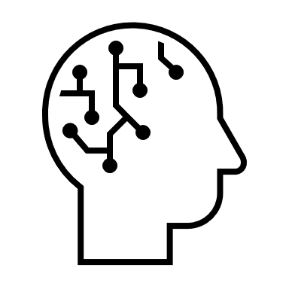
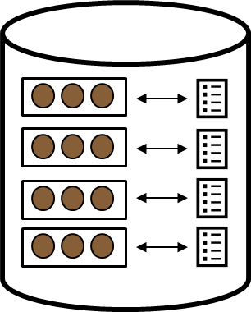
RAG: Synthesize Answer
Relevant Docs
Prompt Template
Prompt
Answer question
based on context:
CONTEXT:
{text}
QUESTION:
{question)
ANSWER:
Retriever
LLM
Question
How to measure relevancy ???
Answer
Notes:
So this is how it’s executed at query time. Here I have a Prompt Template which ask the LLM to answer a question based on the given context. At inference time, when the pipeline receives a query from users, it will first go and ask the retrieval system to find from the knowledge base the relevant information. The retrieved documents are then inserted into the prompt template, together with the question to generate the final prompt, which is then run through the LLM to generate the final answer.
Now the question is how does the retriever know which documents should be extracted? How do we measure relevancy? How should the knowledge base designed to help retrieving the right information?

Slide 7

RAG: Constructing a Vector Database
1
2
3
4
Collect Documents
Split into Small Chunks
Convert Text to Vectors
Store inside Database
Notes:
One way to do it is to embed the documents inside a Vector Database. In vector database, the retriever uses numeric vectors as the search index.
First we collect all relevant documents, split them into smaller text chunks, then we the text though a neural network embedding model to convert the text chunk into vectors. We can then tag the vectors together with the content of the documents and save them inside databases.

Slide 8

RAG: Retrieval
“Dog”
Query
“chihuahua”
“puppy”
Relevant Documents Search using KNN
Notes:
These vectors will be used to calculate the degree of relevancy of the documents with respect to a certain query. The question or query is first also run through the embedding model to generate a vector mapping in the similar space as all our documents. We can then estimate the relevancy by calculating the distance between the point representing the query and the points representing the documents, and simply return the nearest points to the query.

Slide 9
RAG
Fine
-
Tuning
•
No LLM weights update
•
Directly update LLM weights
•
Additional knowledge
•
No additional knowledge
provided via prompts
provided at inference
ü
Model has access to updated
ü
Tasks requiring complex
knowledge
instructions/reasoning
ü
Reduce Hallucination
ü
Tasks requiring specific
format/tone
Increase Token Usage
Initial cost (data preparation,
computation resources, etc)
Notes:
To recap and compare between RAG and Fine Tuning. In a pure RAG implementation, there is no weight update on the LLM, we simply use prompt engineering and in-context learning to guide LLMs and provide additional knowledge. The advantages are that it’s simple and cheap to give LLM access to updated knowledge and reduce hallucination. However, due to all the additional contexts, the token usage tends to be higher.
For fine-tuning, we directly update the model weights, and we don’t really provide additional knowledge during inference. The goal of fine-tuning is usually to improve model to execute tasks which require complex instructions or reasonings, or if we want the model outputs in a specific tone or format. Because fine-tuning requires training the model weights, it tends to be more costly to setup.

Slide 10
Improving LLM capability
RAG
Grounded analytical chatbot
Grounded information extraction chatbot
Knowledge
Empathetical Chatbot
Basic Chatbot
Fine Tuning
Skill
Notes:
To choose whether to use RAG and Fine Tuning, it’s important to know whether how each method helps to improve different aspects of LLM. We can differentiate LLM capability into Knowledge and Skill. Knowledge is measure of information the model knows whereas skill is measure of how well model execute certain tasks, for example, do math, write codes. RAG helps model improve its knowledge and fine-tuning helps the model improve its skills.
Let’s consider building several chatbots. So most basic one would be a general chatbot with no special skills and no domain knowledge. If we fine-tune the model, we can get some skillful bots which can do math, can code or be empathetic in conversation. If we provide the model with knowledge, we can get a chatbot which is a knowledge expert in a certain domain. If we combine RAG and finetuning so that the bot can understand and analyse the retrieved contexts and disregard any noisy information from the contexts.

Slide 11

How to evaluate Retrieval Augmented Generation
Notes:
So now that we have managed to build our first RAG pipeline, we probably want to start evaluating to understand how we can improve the RAG pipeline in the next iteration.

Slide 12
Challenges for RAG evaluation
End-to-end or component-wise metrics
Costly human evaluation/annotation
Domain-specific RAG evaluation dataset
Solution: LLMs for evaluation
Notes:
These are some of the challenges which you may face when you are developing RAG applications.
First, because we are introducing an additional component, the retriever, it becomes more difficult to understand precisely where the answers go wrong. For example, since we are grounding the LLM to working strictly inside the space of the contexts, if our retriever does not extract the passages containing the needed information, there is no way for LLM to generate the correct answer, so this is the retrieval problem. From generation side, we may have retrieved the right information, but maybe the context is too long, containing too many noisy irrelevant information that confuse the model, or maybe the prompt is not instructive enough for the model to process the information well. So especially for optimization and troubleshooting, we may want to component-specific metrics to understand the performance of each part of the pipeline instead of using the end-to-end metric.
Second and third point is about cost of evaluation. We may need to generate a dataset that is specific to our domain, then get human to annotate and evaluate, which is very time-consuming and can induce a lot of cost.
Recently, there has been an increasingly popular solution to utilize LLMs for evaluation, whether as an evaluator or generate evaluation dataset. There’s a paper which shows that GPT-4 evaluation performance aligns pretty well with expert human evaluators, and cost of using GPT is much less compared to employing human to annotate the dataset.

Slide 13



RAG components evaluation
Retrieval
Generation
How relevant and the contexts
How well LLM answer questions
retrieved to query questions
given the contexts
Context Precision
Faithfulness
Measures whether each top retrieved
Measures the factual consistency of the
documents can support the questions.
answer against the given context
RAGAS
Context Recall
Answer Relevancy
Measures how much of the ground truths
Measures the relevancy between answer
are supported by the retrieved contexts.
and question.
Cosine Similarity (answer, question)
Notes:
For RAG, recently there is a cool open-source project called RAGAS for evaluating different aspects of a RAG pipeline. Basically, there are 4 metrics, 2 of them measures how relevant the retrieved documents are and 2 of them measures how well and grounded the generated answers from the LLMs are.
The first retrieval metrics in context precision, this measures how well the retrieved documents can support the query. This is helpful to prevent overfeeding noisy irrelevant information to the LLM, which can cause LLMs to focus on incorrect information and hallucinate.
Context Recall measures the level of information coverage whether the retrieval system can extract all the necessary information required to generate the ground truth answers.
On the generation side, we have metrics like faithfulness which tries to measure the level of grounding of the answers, whether the LLM is answering the question based on contexts or is it inferring from its own knowledge or hallucinating.
The last metric is answering relevancy which measures if the answer actual is helpful in tacking the question. It measures whether given a long context which contains the relevant information, can the model focus on the right information to generate the answers or will it focus on the wrong parts and generate something not useful at all.
I personally like the retrieval metrics a lot since it’s an LLM-based metrics and doesn’t require human annotations for other typical retrieval metrics like hit rate, MRR or MAP.

Slide 14
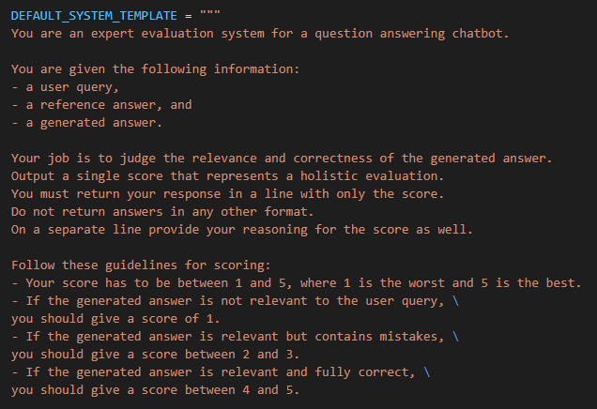
GPT-4 as evaluators
Notes:
Setting up GPT evaluators is also very convenient and flexible, as you can simply change the prompt to whichever evaluation grade schema that fit the clinical problem. Here for example, I can create a framework to rate the correctness and relevance of the answers given the query, RAG response and ground-truth answer on a scale of 1-5 by giving LLM grading instructions inside the prompt.

Slide 15
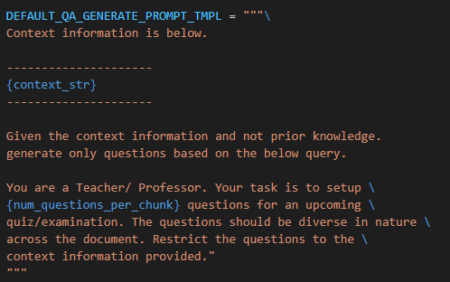
GPT-4 to generate synthetic dataset
Notes:
We can even generate synthetic dataset for RAG evaluation. In this case, I am randomly selecting some retrieved contexts from by database and simply ask GPT to give me a few questions and answers. So by utilizing LLMs, we can really minimize the amount of human effort needed to develop and optimize LLM applications.

Slide 16

How to improve RAG pipeline ?
Notes:
Now that we can properly evaluate different components of RAG, we can start experimenting and optimizing our pipeline by testing different models, different settings and then systematically evaluate which setups are the best for our dataset and use case.

Slide 17
End-to-end Performance
Retrieval Performance
Generation Performance
Question-Document Mapping
Information Coverage
Complex document relationship
Multi-Modal Documents
Generation Bias
Hallucination
HyDE
Embedding Fine Tuning
Summary Embedding
Re-Ranking
Query Expansion
Chunk size / Top k tuning
Metadata Filtering
Sub-query retrieval
Knowledge Graph
Multi-hop retrieval
Text-to-SQL Engine
Document Agents
Long Context Reorder
Prompt Engineering
RA-DIT
Rule-based
Contexts Reformatting
And many more !!!
Notes:
This is a summary of a few optimization tricks that you can use to improve the performance of RAG.
For example, you can try to improve the mapping between query and documents in vector space by fine-tuning the embedding model, or generate hypothetical answer and use that as the retrieval query instead of the original question.
Maybe you find that the context recall is low, meaning that retriever is not collecting enough information, a few things that you can do is like adding extra text before and after the original chunk, use a larger chunk size or retrieve more documents.
Sometimes the documents can have complex relationship which may require building a knowledge graph or sequential multi-hop retrieval.
If you find that your retriever can retrieve the information but for some reason, the LLM just refuse to interpret up the right information, then it’s probably due to generation performance. You can try to optimize the prompt to give more explicit instructions, adding certain rule-based, re-order the retrieved contexts as LLMs tend to be bias towards the information at the top and bottom of the contexts and ignore the information in the middle. You can also fine-tune the LLM to improve its ability to interpret the contexts or understand when the contexts are not useful.
This is not an exhaustive list and the community is continuously inventing new solutions to improve the quality of RAG.

Slide 18

Prompt Engineering
Role
Instructions
Contexts
Output Instructions
Examples/History
Question
Notes:
As we try out new techniques, I think it’s also important to stick to some of the basic good practices which can really help to improve the performance without needing to spend much effort. First, focus on your prompt, make sure that you have a clear and instructive prompt which guide the LLM tackle the problem that you want to solve. This can be your first baseline, where you try to play with the prompt, adding Chain Of Thoughts steps, adding few-shot examples.

Slide 19
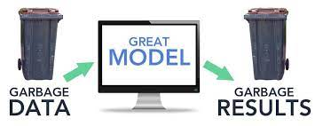
Understand your data
Remove unnecessary documents
Source: ACR shoulder pain traumatic.pdf, page 19
Page Content: 25. Rutten MJ, Collins JM, de Waal Malefijt MC, Kiemeney LA, Jag er GJ. Unsuspected sonographic findings in patients with posttraumatic shoulder complaints. J Clin Ultrasound. 2010;38(9):457-465.
26. Kamasaki T, Hayashida N, Miyamoto I, et al. PET/CT shows subjective pain in shoulder joints to be associated with uptake of (18)F -FDG. Nucl Med Commun. 2014;35(1):44-50. …
22-year-old Chinese Male. No significant past medical history. Right shoulder pain for 2 weeks after being tackled in rugby match…
Source: ACR shoulder pain traumatic.pdf, page 8
Page Content: Appropriately positioned radiographs can exclude shoulder dislocation and most displaced fractures as the etiology for post -traumatic shoulder pain. In the setting of normal shoulder radiographs, the most common causes of post -traumatic shoulder pain are soft -tissue injuries such as rotator cuff and labral tears.
Notes:
Before you start incorporating contexts and retrieval, try to understand the data that you ultimately want to provide and more importantly what you don’t want to provide to the LLM
For example, when I was using medical guidelines as the knowledge base and try to find information relevant to a patient summary, I found that among the texts, the retriever is also extracting information under the reference sections of the documents which do not contain any useful information. This is information that can actually be easily excluded when we construct the knowledge base.

Slide 20
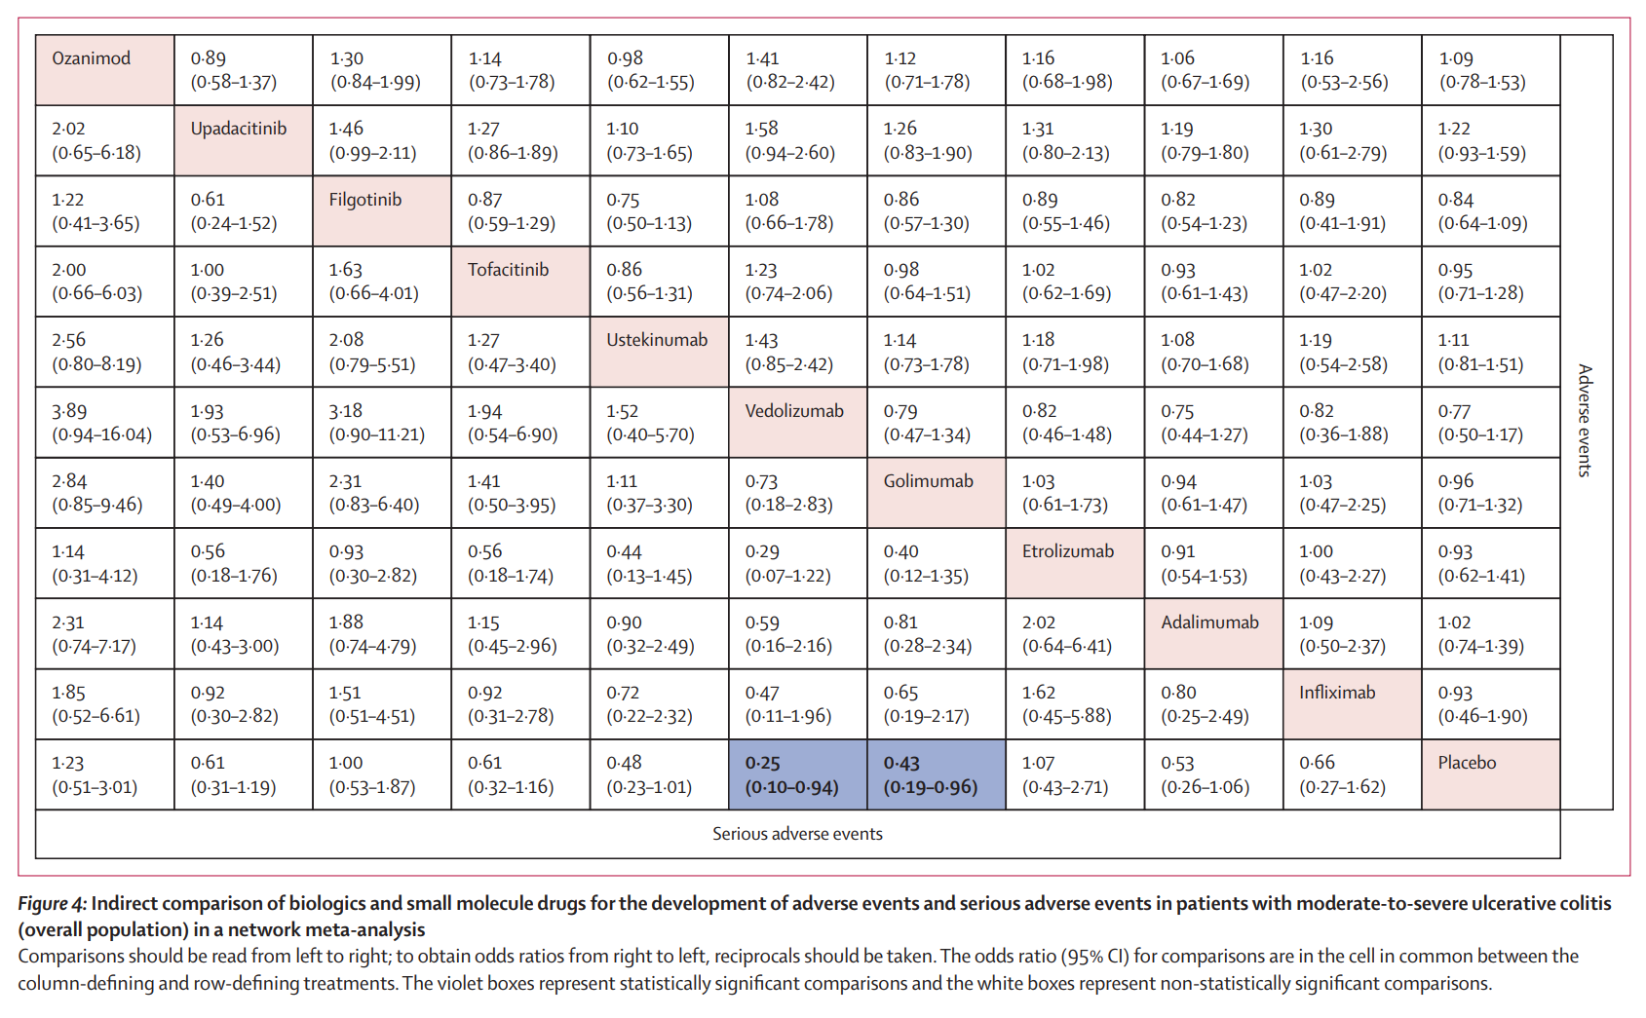
Understand your data
Consider embedding content
Notes:
Second is what is the content that we want to map the relevancy of our question to documents to make sure that the embedded query and embedded documents is as close as possible in our vector space. For example, for tricky data like tables, we found that the retriever works much better when we just embed the table description than when we embed both descriptions and table contents, probably because the numbers inside the table do not carry a lot of semantic meaning and hence dilute the vector representation. Both retrieval and end-to-end performance significantly improve when we just use the table description for embedding. When we also add relevant metadata inside the embedding text, we also managed to improve by additional percent points.
On the other hand, we also want to consider what are the context we want to the model to interpret. While we use the text descriptions for relevance mapping, we should feed the table content to the LLM as it contains the information needed for answering the question.

Slide 21
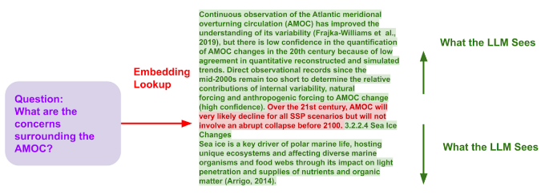
Understand your data
Consider input contexts
Notes:
One technique is query expansion is we use short text for embedding lookup to reduce noise but then expand the context when we feed the information to the LLM.

Slide 22
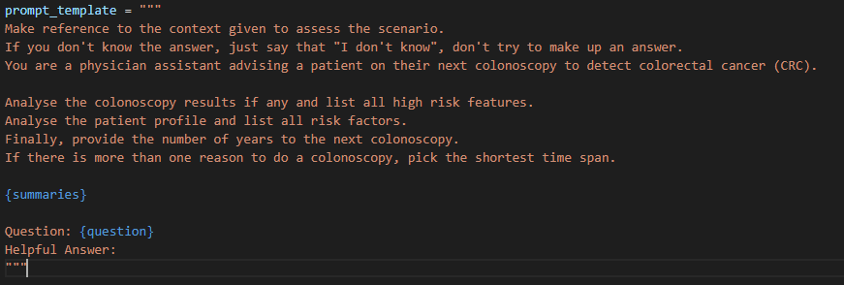
Understand the clinical problem
Break the problems into sub-problems
Chain Of Thought Prompting
Notes:
Next, understanding the clinical problem can help in several ways.
You can construct better prompt by breaking down the problem and guide the LLM step-by-step.

Slide 23
Understand the clinical problem
Break the problems into sub-problems
Sub-Query RAG
Table Database
Synthesizer Prompt
Final Answer
Question
Text Database
Notes:
You can design to have several retrievers to extract different types of data and then combine them together.

Slide 24
Understand the clinical problem
Break the problems into sub-problems
Multi-step retrieval
Question
Metadata Filter
Vector Database
Synthesizer Prompt
Final Answer
Notes:
You also design multistep retrieval by first extract the relevant text that contains certain metadata keywords, and then use a re-ranking to find the most relevant information.

Slide 25
Finetuning
Embedding Models: Contrastive Learning
LLM Models: Context-Aware Instruction RLHF/SFT
Combine Embedding & LLM Finetuning: RA-DIT
Notes:
Lastly, when all these techniques don’t work, then we move to fine-tuning. To improve the retriever, we can finetune the embedding model, to improve the answer generation that is more context aware, we can finetune the LLM with supervised finetuning or RLHF. Finally, there are SOTA techniques which finetune both embedding and LLM together.

Slide 26
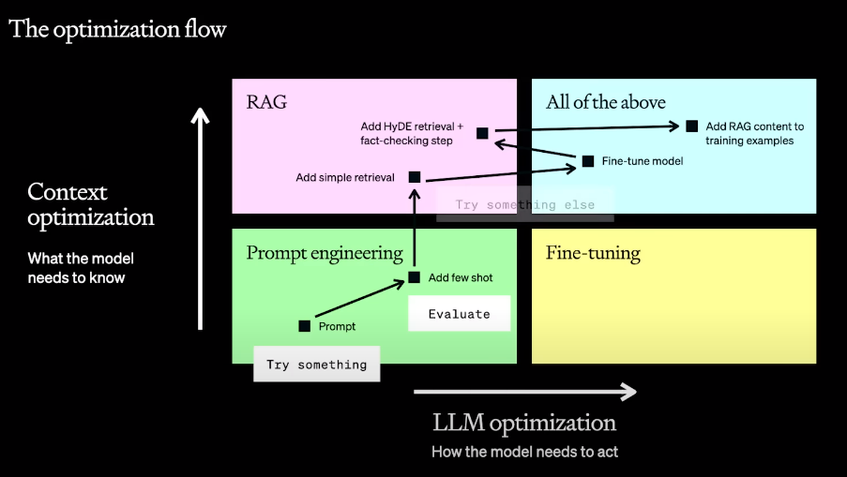
Optimization Flow (OpenAI Dev Day)
Notes:
Just borrowing this slide from OpenAI team during their Dev day. Start simple with simple prompt and few shot, then add simple retrieval then move to more complex retrieval system or training depending on your need, along the way systematically evaluate and analyse where your application goes wrong to implement the appropriate solution.

Slide 27

Coding Time !
Download Jupyter Notebook at:
https://tinyurl.com/ai-summit-2023
Notes:
With that let’s move on to the coding part.

